Slide 1


MOVIE RECOMMENDATION SYSTEM DATA SCIENCE Capstone Project
By,
LubNa RAHMAN

Slide 2
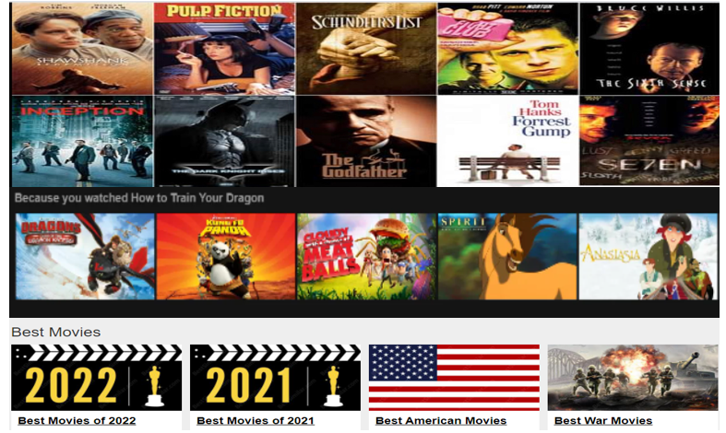

Slide 3
Recommendation system: An OVERVIEW
Recommendation System is an information filtering system.
Predicts the rating or the preference a user might give to an item.
Is ubiquitous because of abundant data.
Growing in popularity in the world of predictive modeling and Machine Learning.
Greatly influences with what we interact with the world.
Netflix, YouTube, Facebook, and Amazon are some popular recommender systems in use.

Slide 4

Recommendation system: Influencing EVERYDAY LIVES

Slide 5
PROJECT GOALS
Companies are more interested in recommender systems to analyze patterns of user interest in products and provide personalized recommendations. Hence, the goals for this recommendation system project are:
Understanding, analyzing and correlating the trend in movie ratings per genre.
Building a recommender engine to provide recommendations to different users using Machine Learning algorithms.

Slide 6
PROJECT OVERVIEW
Building a movie recommendation system to provide recommendations to number of users with numerous movies.
Recommendation is done based on :
Similarity between users (Collaborative Filtering), or
Considering particular user’s activity (Content Based Filtering) which they want to engage with.

Slide 7
BUSINESS OBJECTIVE
The recommender engine is useful to the businesses that earns revenue via recommendations.
Providing good recommendations will help users save time searching for their favorite movie.
This will help the customer to continue with the service.
Clients of this project could be Amazon, Netflix, Hulu, YouTube.

Slide 8
WORKFLOW
The recommendation system project workflow includes:
Data collection
Data Wrangling
Exploratory Data Analysis(EDA)
Pre-processing and Modeling
Conclusion and Future works

Slide 9

DATA Collection
Data Source: https://grouplens.org/datasets/movielens/25m/
Obtained from MovieLens, an online recommendation service.
The dataset has two dataframes, the ‘ratings’ dataset and the ‘movies’ dataset.
The ‘ratings’ dataset consists of around 25 million user ratings
The movies dataset provides information about the movie name, genre and the year of release.

Slide 10
DATA WRANGLING
The dataset was clean and had no missing values.
The 'ratings'dataset has 25,000,095 rows and 4 columns, and
The 'movies'dataset has 62,423 rows and 3 columns.
The 'genres’ column was separated from the movies dataset and merged with the ratings dataset for better data exploration.
The ‘year’ part was removed from the 'title' column and,
'year' and 'Decade’ were made as separate columns.

Slide 11
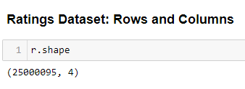
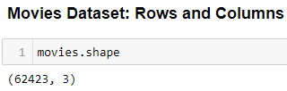
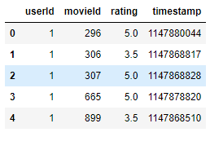
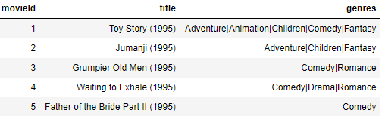
RATINGS AND MOVIES DATASET

Slide 12
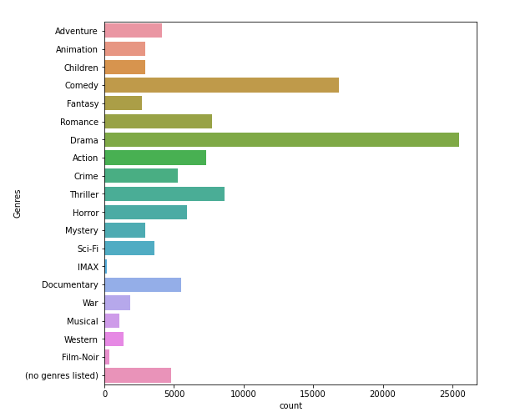
EXPLORATORY DATA ANALYSIS
Total number of movies per each Genre: Drama and Comedy have the most production followed by Thriller, Romance and Action.

Slide 13
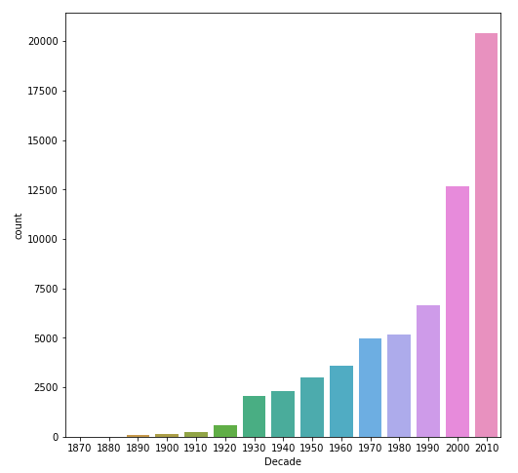
EXPLORATORY DATA ANALYSIS
Total number of movies in each decade: The plot shows an increasing trend with most of the production being in the 2010 decade.

Slide 14
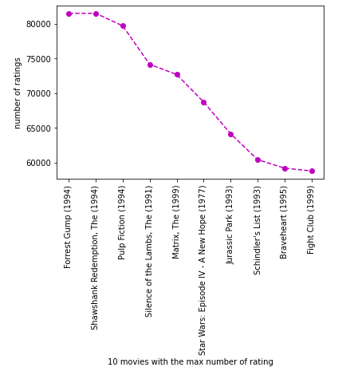
Top ten movies
The top 10 movies with highest ratings are: Forrest Gump, Shawshank Redemption and Pulp Fiction .

Slide 15
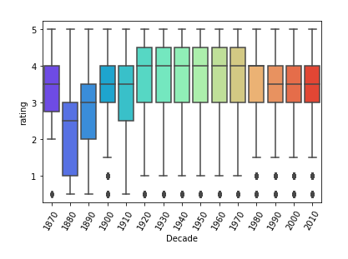
Rating Vs Decade
The boxplot below shows that the movies of the decade spanning from 1920 to 1970 have the highest ratings.

Slide 16
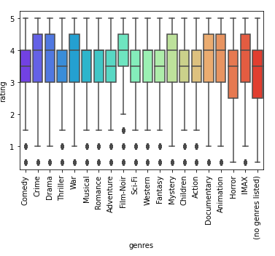
Rating Vs GENREs
The boxplot shows that Drama, Crime, War, Mystery are some of the most highly rated genres while Horror is the least favorite.

Slide 17
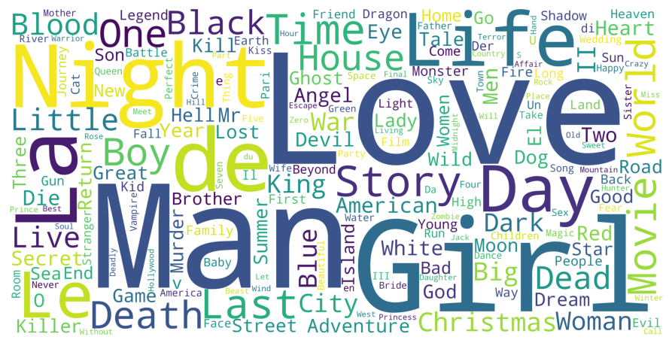
WORD CLOUD
The word cloud for movie ‘Titles’ : The most common word used in movie titles is "Love”.

Slide 18
MODELING
1. Simple Recommender: It generalizes the recommendations to users based on movie popularity, ratings and genre. Hence, popular and highly acclaimed movies will have higher probability of being liked by the audience.
2. IMDb weighted rating formula: It publishes weighted vote averages rather than just raw data averages. In other words, although we accept and consider all votes received by users, not all votes have the same impact (or 'weight') on the final rating.
3. Content based filtering: It uses item features to recommend other items similar to what the user likes, based on their previous actions or explicit feedback.
4. Collaborative Filtering: It uses algorithms to filter data from user reviews to make personalized recommendations for users with similar preferences. For this project Matrix Factorization based collaborative filtering algorithms have been used.

Slide 19
MATRIX FACTORIZATION
The different matrix factorization based algorithms used in this project are:
Singular Value Decomposition(SVD)
SVD++
LightFM
Alternative Least Square (ALS) collaborative Filtering

Slide 20
Singular VALUE DECOMPOSITION(SVD)
SVD is a matrix factorization technique that is used to reduce the number of features of a dataset by reducing the space dimensions from N to K, where K< N.
For the recommendation systems, we will focus on the matrix factorization keeping the same dimensionality. It is done on the user-item ratings matrix.
Surprise library was used which consists of several powerful algorithms like SVD, NMF(Non-negative Matrix Factorization). KNN(K- Nearest Neighbor) and Co-Clustering, to minimize the RMSE(Root Mean Square Error) and give accurate recommendations.

Slide 21
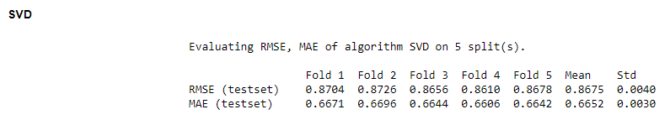
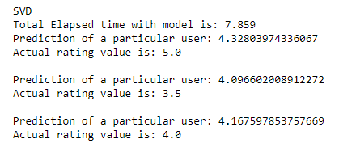

SVD: Observations

Slide 22
SVD++
As the results from the SVD model did not improve even after hyperparameter tuning, we tried the model SVD++.
SVD++ algorithm is an extension of SVD that takes into account the implicit ratings. In other words, it as an optimized SVD algorithm to enhance the accuracy of prediction by generating implicit feedback.
However, SVD++ also did not give us any good results. The RMSE for this algorithm was still found to be around 0.65.

Slide 23
LIGHTFM mODEL
LightFM is a Python implementation of a number of popular recommendation algorithms for both implicit and explicit feedback.
It is a hybrid matrix factorisation model representing users and items as linear combinations of their content features' latent factors.
It also makes it possible to incorporate both item and user metadata into the traditional matrix factorization algorithms.
It represents each user and item as the sum of the latent representations of their features, thus allowing recommendations to generalise to new items (via item features) and to new users (via user features).
The LightFM model gave us the precision at K score of around 0.053 and an AUC score of 0.91, which is quite good. To further improve the model, we tried Hyperparameter Tuning.
Hyperparameter Tuning, improves the model performance by roughly around 3%. Hence, this model is considered a good recommender system for this dataset.

Slide 24
Alternating Least Square(ALS)
ALS is also a matrix factorization algorithm, which factorizes a given matrix R into two factors U and V such that R≈UTV.
The unknown row dimension is given as a parameter to the algorithm and is called latent factors.
AlS is an iterative optimization process where for every iteration, we move closer to an factorized representation of our original data.
We will use this model to fit our data and find the similarities.
It was observed that the ALS model gives good scores and hence, good recommendations for this dataset.

Slide 25
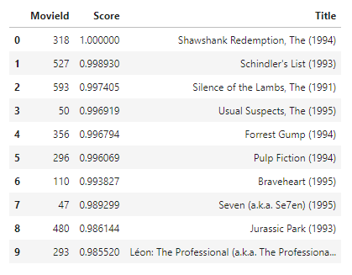
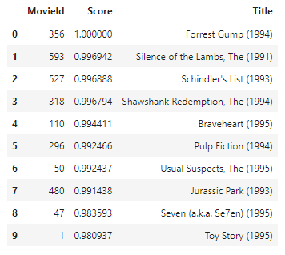
ALS: Observations
1. Movies similar to Shawshank Redemption 2. Movies similar to Forrest Gump

Slide 26
Questions?

Slide 27
THANK YOU!

